Slide 1
Ethical Hacking – Lecture 11
John Black Fall 2020

Slide 2
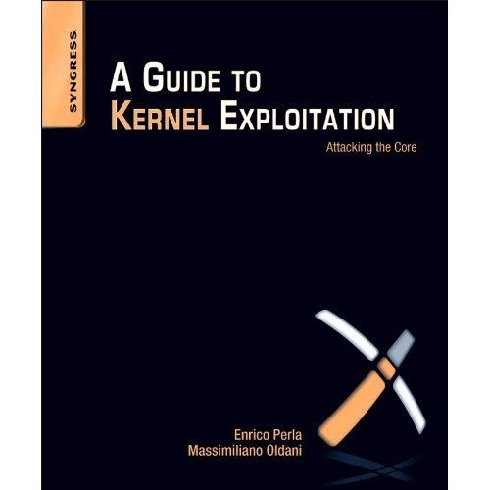
Linux Attack Wrap-Up
There are a LOT of other local-attacks that we haven’t covered
setjmp/longjmp overflows
LOCALE attacks
heap exploits
heap overflow (vortex 11)
Depends on obscure details about the heap implementation
double frees
Language-specific hacks
.dtors is specific to gcc
vtables in C++
kernel hacks

Slide 3
Countermeasures
Obvious fix: write decent code! (impossible)
Let’s just hamstring the OS, destroy performance, and break the language’s backward compatibility in the name of security…
OK!
(This is the trend)
Let’s revisit the attacks we’ve just seen over the past 2 weeks and look at prevention/mitigation

Slide 4
Razor 1-3
Level 1
Don’t expose hashes of passwords
Don’t use traditional crypt() or MD5
Modern Unixes use MD5 x 1000 or SHA-x
Don’t pick dumb passwords
Ask Aaron Barr or Ted Vera
Level 2/3
Don’t use system(), popen(), execlp(), ~, etc., or anything else affected by the external environment

Slide 5
Razor 4-5
If you’re accepting user input, be extremely careful
Sanitize
Sanitize by allowing valid inputs and disallowing all else
This can be tricky… do you allow “/” in a file name?
do you allow “.” in a filename
then you allow “../../../..” right?
Sanitizing correctly can be very hard

Slide 6
Buffer Overflows
Remove bugs from your programs
Static Analysis
Somewhat successful, but doesn’t always catch everything
Use Java
Bounds checking, no pointer arithmetic, not that slow nowadays
But writing an OS in Java? I don’t think so…
ASCII armoring
Force all text into the 0x00000000 – 0x00ffffffff and mark that as the only executable segment
Injecting jumps here will require a 00 byte
This is only a partial-solution

Slide 7
Nonexecutable Stack (NX(amd), XD(intel))
Comes in a few forms
W^X (OpenBSD), ExecShield (RedHat), DEP (MS), PaX (many Linux kernels… this includes canaries)
Can’t run injected code in the buffer or envp array
We can still inject parameters and then return to libc
Put “/bin/sh” into buffer, overwrite ret address with the address of system() (for example)
Requires that you know the addresses of libc entries and that these addresses are stable
Requires that you can overwrite the return address
It’s possible to call several libc routines, incidentally
Eg, overwrite ret address with setresuid()’s addr, then put a fake sfp and system()’s addr; this is “Return Oriented Programming” or ROP
Stacks are executable on razor

Slide 8
Canaries
Run-time generates a random 4-byte quantity and pushes it between sfp and the called function’s locals
Upon exit, the canary value is checked to ensure it was not overwritten
i | 4 bytes | 0xbffff980
char *tmp | 4 bytes | 0xbffff984
Canary | random 4 bytes | 0xbffff988
sfp | 4 bytes | 0xbffff98c
ret addr | to libc | 0xbffff990
argc |  | 0xbffff994
argv |  | 0xbffff998
envp |  | 0xbffff99c

Slide 9
Canaries: Notes
Note that the value must be random
Introduces substantial overhead
If we can overwrite arbitrary memory (think format string vulnerabilities) then we can overwrite canaries
Canaries are always in writable memory
Think about it

Slide 10
Canary Bypass Techniques
If you can overwrite a ptr that’s the target of a strcpy
strcpy(dest, user_input)
user_input | 256 bytes | 0xbffff980
char *dest | 4 bytes | 0xbffff984
Canary | random 4 bytes | 0xbffff988
sfp | 4 bytes | 0xbffff98c
ret addr | 4 bytes | 0xbffff990
argc |  | 0xbffff994
argv |  | 0xbffff998
envp |  | 0xbffff99c

Slide 11
Around the Canary (cont.)
Weak sources of entropy sometimes used for random-number generator
Usually requires local access to the machine
Several famous cases in other contexts
Overwrite stored canary
This is a bit silly: if you can overwrite arbitrary memory, just write the ret addr directly

Slide 12
Forked Child Attack
If a child is forked, it will have the same canary as the parent
This leads to a very clever attack
Overflow one byte at a time and watch behavior of child

Slide 13
Address Space Layout Randomization
Idea: mmap maps text, data, and stack into random virtual addresses
For overflows, you don’t know where the buffer is, you don’t know where your env variables are, you don’t know where libc is
Specific example: PaX
text and data randomized with a 16-bit base, stack with a 24-bit base (32 bit machine)
Address base for text and data:
0000 xxxx xxxx xxxx xxxx 0000 0000 0000
so we can allocate large chunks
ensure page-boundary alignment

Slide 14
Bypassing ASLR
With only 16 bits of entropy, we have only to guess a max of 65536 times (expected 32768 tries)
Stanford paper
http://crypto.stanford.edu/~dabo/abstracts/paxaslr.html
They fitted Apache with a simple overflow
Took advantage of the fact that fork()’ed children could be crashed and would respawn
If you find the random bits of any child, you get the offset for all children
216 seconds on average to win

Slide 15
ASLR (cont)
On 64-bit machines this will be impractical
Non-executable stacks, ASLR, and canaries provide a good deal of security against overflows
As a result, we are seeing a shift from these binary attacks to content-based and application-based attacks

Slide 16
Format String Countermeasures
Compiler errors (instead of warnings)
Fix those bugs
Disable %n
That breaks C/C++
Microsoft already implements this
ASLR
Even if you can write an address of your choice, what address do you choose?
Around 2000 there were TONS of these vulnerabilities, but the above countermeasures have largely erased them
Compared to buffer overflows, format string bugs are quite easy to find

Slide 17
Side Topic: What do you do IF you break in?
We just go to the next level ☺
For real though
Open a reverse shell?
Probably will get spotted
Add a new user?
Ditto
Use a root kit
This is the only correct answer

Slide 18
Linux Rootkits
There are 20-30 of them on the internet
SucKit was included in Phrack
I assigned a very basic one in 3753 when I taught that class!
The goal is to confer power, be resilient to reboots, forensic tools, etc., and stay invisible
Power is easy
Resilience means installing restart code into the boot sequence
Invisibility is the challenge
ps, w, top, /proc shouldn’t show the process
stat shouldn’t give the inode of any files used
don’t log any activities
Loadable Kernel Modules mechanism often used
Look at rkit.c on razor

Slide 19
Th-th-th-that’s all (for now)
The operating system will play a central role as we migrate into the web-based portion of the class as well
We forgot to talk about Windows! (Yay?)
There are significant differences from Linux, but the core concepts are the same
Any other Oses?
OS X is a bsd derivative, iOS is a mini-OS X, Android is a Linux-derivative, very few things are not based on Unix/Linux or Windows
VMS is still around, actually

